Slide 1
“Penjualan Mobil”
Pemrograman Berorientasi Object
Kelompok 4
Kriswwantoro 17030
Mila Haryani 17030
Pricilia Dwi Widyaastari 1703044
Saji Yogi Permana 17030

Slide 2
Penjelasan
Pemrograman Berorientasi Object
Tema aplikasi yang kami buat adalah penjualan mobil. Aplikasi ini dibuat menggunakan JavaScript, dengan tampilan desktop. Dimana aplikasi itu dapat dioperasikan oleh admin. Didalamnya dapat menginputkan atau mengisi form mobil, faktur, pembeli, dan transaksinya. Admin juga dapat melihat daftar mobil, pembeli, faktur dan transaksi yang sudah dilakukan. Hal ini memungkinkan untuk mempermudah pekerjaan admin dan mempersempit bukti transaksi yang hilang dibanding cara manual.

Slide 3
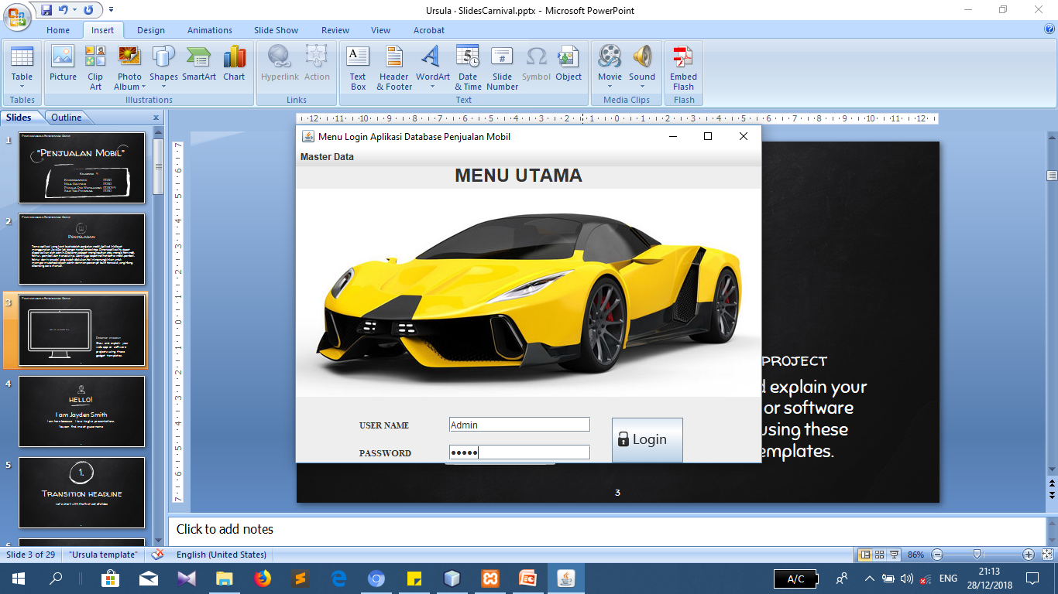
Pemrograman Berorientasi Object

Slide 4
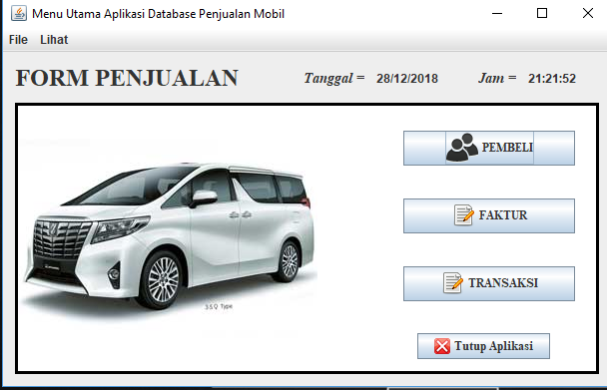
Pemrograman Berorientasi Object

Slide 5
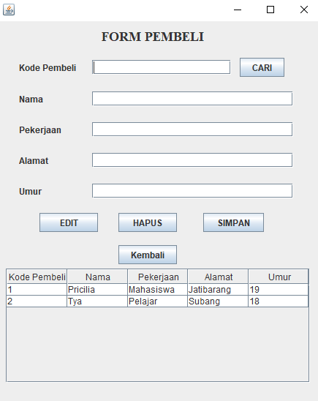
Pemrograman Berorientasi Object

Slide 6
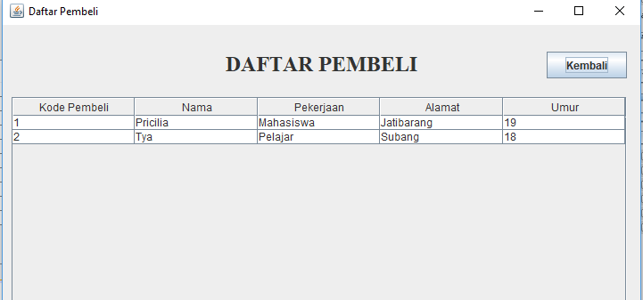
Pemrograman Berorientasi Object

Slide 7
1. Inheritance
Pemrograman Berorientasi Object
Let’s start with the first set of slides

Slide 8
2. Polymorphism
Pemrograman Berorientasi Object
Let’s start with the first set of slides

Slide 9
3. Encapsulation
Pemrograman Berorientasi Object
Let’s start with the first set of slides

Slide 10
4. Method Overloading dan Overriding
Pemrograman Berorientasi Object
Let’s start with the first set of slides

Slide 11
5. Constructor
Pemrograman Berorientasi Object
Let’s start with the first set of slides

Slide 12
6. Try, catch, finally, throw dan trows
Pemrograman Berorientasi Object
Let’s start with the first set of slides

Slide 13
7. Konektivitas Database
Pemrograman Berorientasi Object
Let’s start with the first set of slides

Slide 14
Pembagian Tugas
Pemrograman Berorientasi Object
Let’s start with the first set of slides

Slide 15
Quotations are commonly printed as a means of inspiration and to invoke philosophical thoughts from the reader.

Slide 16
This is a slide title
Here you have a list of items
And some text
But remember not to overload your slides with content
Your audience will listen to you or read the content, but won’t do both.

Slide 17
Big concept
Bring the attention of your audience over a key concept using icons or illustrations

Slide 18
You can also split your content
White
Is the color of milk and fresh snow, the color produced by the combination of all the colors of the visible spectrum.
Black
Is the color of coal, ebony, and of outer space. It is the darkest color, the result of the absence of or complete absorption of light.

Slide 19
In two or three columns
Yellow
Is the color of gold, butter and ripe lemons. In the spectrum of visible light, yellow is found between green and orange.
Blue
Is the colour of the clear sky and the deep sea. It is located between violet and green on the optical spectrum.
Red
Is the color of blood, and because of this it has historically been associated with sacrifice, danger and courage.

Slide 20
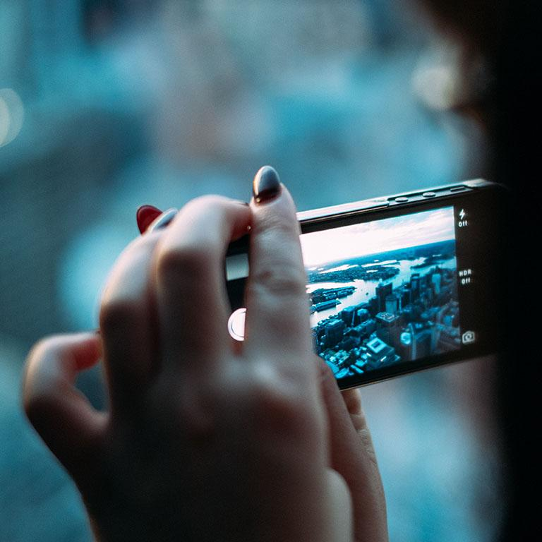
A picture is worth a thousand words
A complex idea can be conveyed with just a single still image, namely making it possible to absorb large amounts of data quickly.

Slide 21
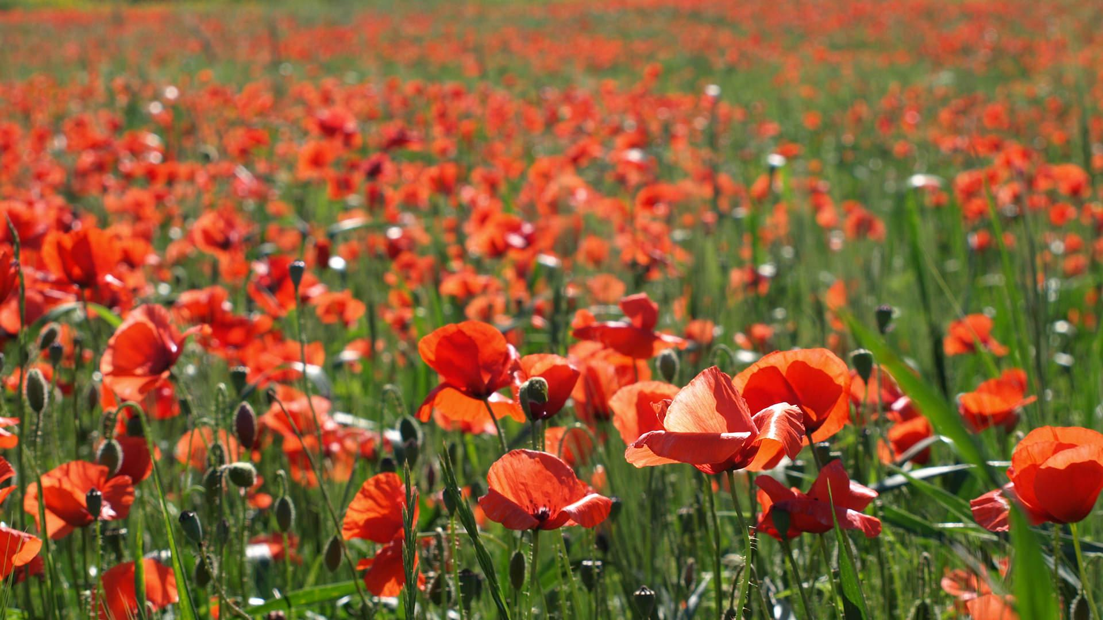
Want big impact?
Use big image.

Slide 22
Use charts to explain your ideas
White
Gray
Black

Slide 23
And tables to compare data
 | A | B | C
Yellow | 10 | 20 | 7
Blue | 30 | 15 | 10
Orange | 5 | 24 | 16

Slide 24
Maps
our office

Slide 25
89,526,124
Whoa! That’s a big number, aren’t you proud?

Slide 26
89,526,124$
185,244 users
100%
That’s a lot of money
And a lot of users
Total success!

Slide 27
Our process is easy
first
second
last

Slide 28
Let’s review some concepts
Yellow
Is the color of gold, butter and ripe lemons. In the spectrum of visible light, yellow is found between green and orange.
Blue
Is the colour of the clear sky and the deep sea. It is located between violet and green on the optical spectrum.
Red
Is the color of blood, and because of this it has historically been associated with sacrifice, danger and courage.
Yellow
Is the color of gold, butter and ripe lemons. In the spectrum of visible light, yellow is found between green and orange.
Blue
Is the colour of the clear sky and the deep sea. It is located between violet and green on the optical spectrum.
Red
Is the color of blood, and because of this it has historically been associated with sacrifice, danger and courage.

Slide 29
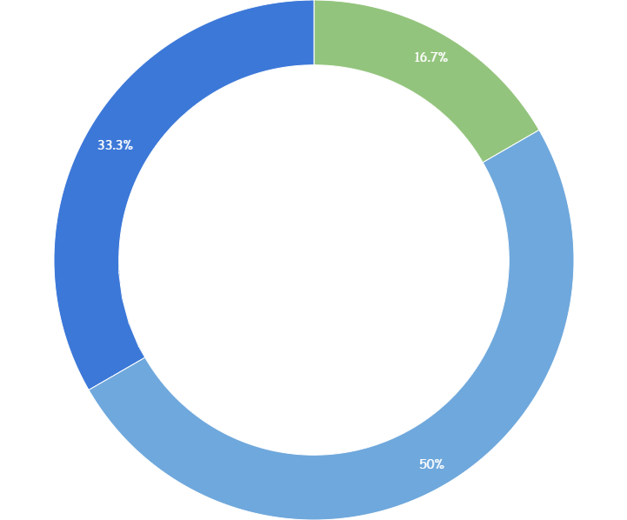
You can copy&paste graphs from Google Sheets

Slide 30
Place your screenshot here
Android project
Show and explain your web, app or software projects using these gadget templates.

Slide 31
Place your screenshot here
iPhone project
Show and explain your web, app or software projects using these gadget templates.

Slide 32
Place your screenshot here
Tablet project
Show and explain your web, app or software projects using these gadget templates.

Slide 33
thanks!
Any questions?
You can find me at
@username
user@mailme

Slide 34
Credits
Special thanks to all the people who made and released these awesome resources for free:
Presentation template by SlidesCarnival
Photographs by Unsplash

Slide 35
Presentation design
This presentation uses the following typographies:
Titles: Walter Turncoat
Body copy: Sniglet
You can download the fonts on these pages:
https://www.fontsquirrel.com/fonts/walter-turncoat
https://www.fontsquirrel.com/fonts/sniglet
You don’t need to keep this slide in your presentation. It’s only here to serve you as a design guide if you need to create new slides or download the fonts to edit the presentation in PowerPoint®

Slide 36
SlidesCarnival icons are editable shapes.
This means that you can:
Resize them without losing quality.
Change fill color and opacity.
Isn’t that nice? :)
Examples:

Slide 37
😉
Now you can use any emoji as an icon!
And of course it resizes without losing quality and you can change the color.
How? Follow Google instructions https://twitter.com/googledocs/status/730087240156643328
✋👆👉👍👤👦👧👨👩👪💃🏃💑❤😂😉😋😒😭👶😸🐟🍒🍔💣📌📖🔨🎃🎈🎨🏈🏰🌏🔌🔑 and many more...

Slide 38
Extra graphics

